Slide 1

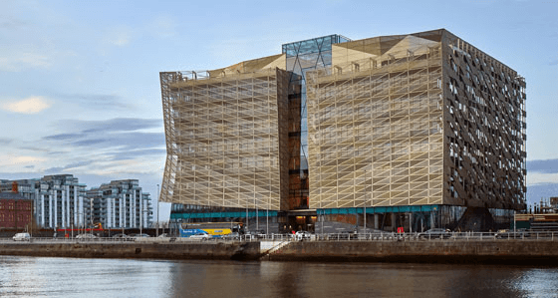
Jason Crowley
Human Resources Pensions Associate Intern – Central Bank Of Ireland
About the bank
Primacy of the Public Interest
Working with Integrity and Transparency
Respecting and Valuing Each Other as Colleagues
Creating a Fulfilling and Progressive Work Environment
Encouraging Vigorous Debate, Constructive Challenge and Effective Risk Mitigation
Being Accountable for Our Performance
Operating Effectively and Efficiently
Collaborating and Working as a Team to Achieve our Goals
The Role
Dealing with general pensions queries, pension transfers, trustee queries, active staff member queries.
Preparing Leaving Service Statements to ensure that we meet deadlines and avoid being out of compliance
Managing personnel files and the pensions inbox
Organising Retirement Functions
Preparing retirement statements for members of the bank’s pension scheme who left the bank and are entitled to a pension
Preparing pension rate of pay requests for HR Support
Learning Opportunities
Monthly Directorate Meetings
Monthly Meetings with the Head of Function
Monthly huddle wall meeting where various informal events are recognised.
Weekly meetings with both my manager and the team.
Remote Working
Skills Developed over the course of my Internship
Directorate Structure
HR Director
Head of Division
Head of Function
Bank Professional 1
Bank Professional 2
Bank Professional 3
Bank Executive
Bank Officer
Time management
Attention to detail
Organisational skills
Communication Skills
IT Skills
Evaluation
What is next?
Learned a lot about my myself
Gained invaluable experience in a highly specialized area of HR
Gained confidence and belief in myself which I can carry forward in the future
Final Year at NCI
Continue to work hard in my degree to help me find employment once I am finished my degree
Practice Psychometric tests to hopefully give myself a chance of an interview

